Slide 1

Notes:
Today we are concluding our verse-by-verse study of 1 Peter in our series, Sojourners: Living Faithfully in Exile. If you’re just joining us, as many Messiah students are this morning, fear not, I’m going to briefly review what we’ve covered in this book.
Each week we’ve drawn our attention to 1 Peter 2:11-12, which are key verses in Peter’s letter… NEXT SLIDE]

Slide 2
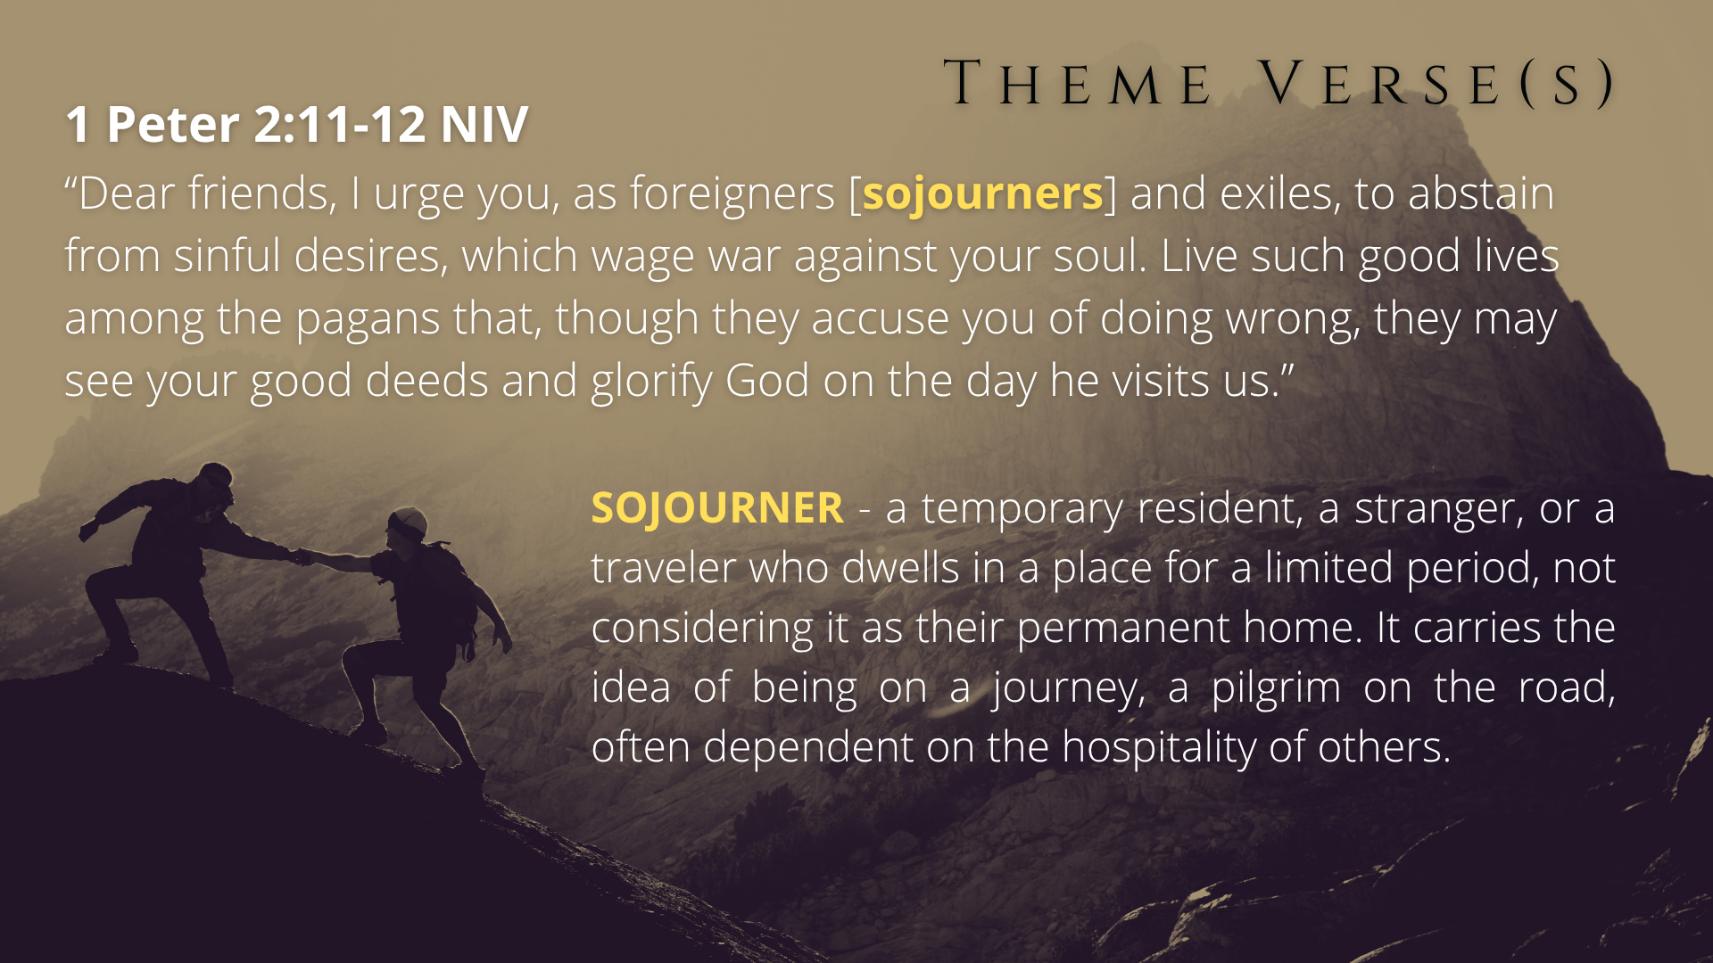
Notes:
He says, “Dear friends, I urge you, as foreigners [ESV: sojourners] and exiles, to abstain from sinful desires, which wage war against your soul. Live such good lives among the pagans [unbelievers] that, though they accuse you of doing wrong, they may see your good deeds and glorify God on the day he visits us.”
So, Peter, like other New Testament authors, wants us to see ourselves as strangers, foreigners, aliens and exiles, pilgrims, and sojourners in this world. He wants us to keep on doing good and letting Jesus shine in us and through us to the world, so that we can be assured that we are running our race well until we reach the finish line or Jesus returns.
As for some of the background and context of this letter… [NEXT SLIDE]

Slide 3
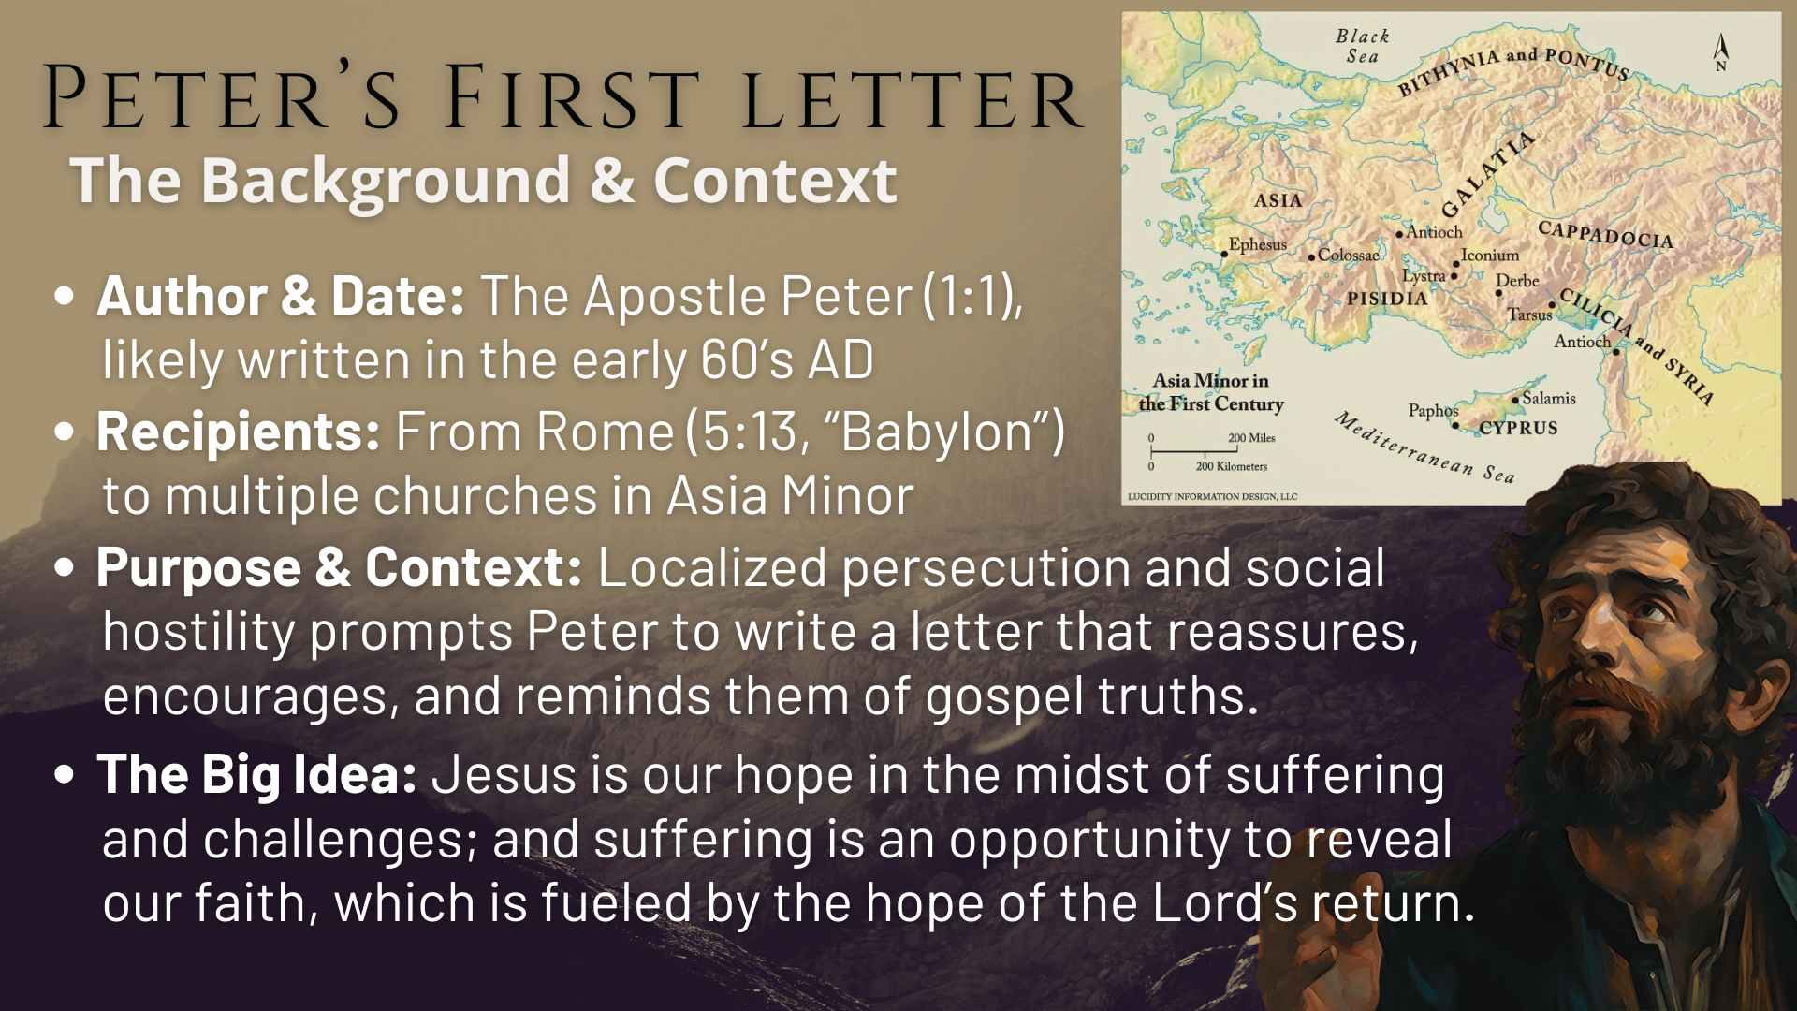
Notes:
Author & Date: The Apostle Peter (1:1), likely written in the early 60’s AD
Recipients: From Rome (5:13 - “Babylon”) to multiple churches in Asia Minor
Purpose & Context: Localized persecution, hardships, and social hostility prompts Peter to write a letter that reassures, encourages, and reminds them of gospel truths.
The Big Idea: Jesus is our hope in the midst of suffering and challenges; and suffering is an opportunity to reveal our faith, which is fueled by the hope of the Lord’s return.
And in the past 8 weeks, here is what we’ve heard the Spirit say… [NEXT SLIDE]

Slide 4
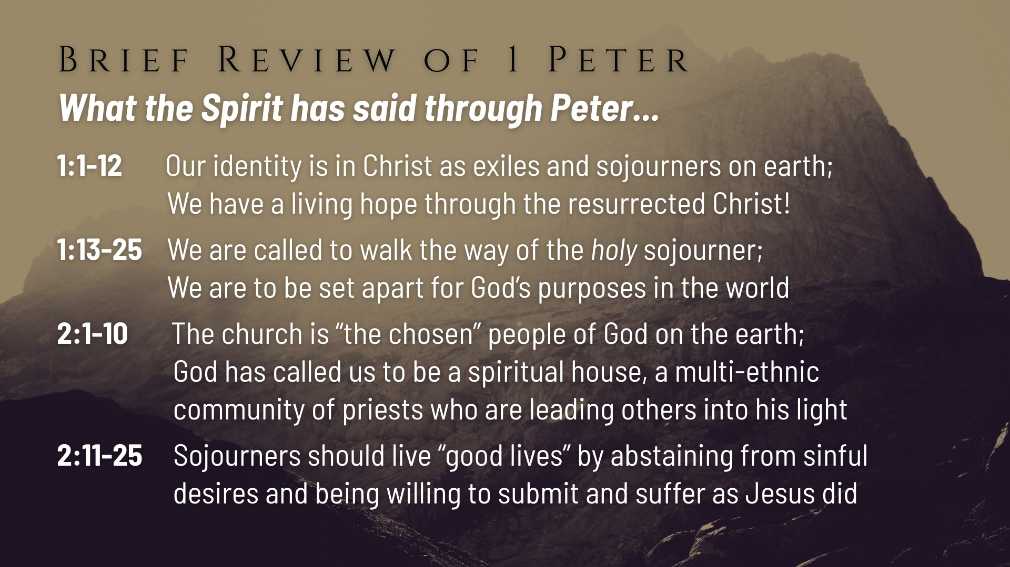
Notes:
[READ SLIDE & COMMENT]
And then in chapter 3… [NEXT SLIDE]

Slide 5
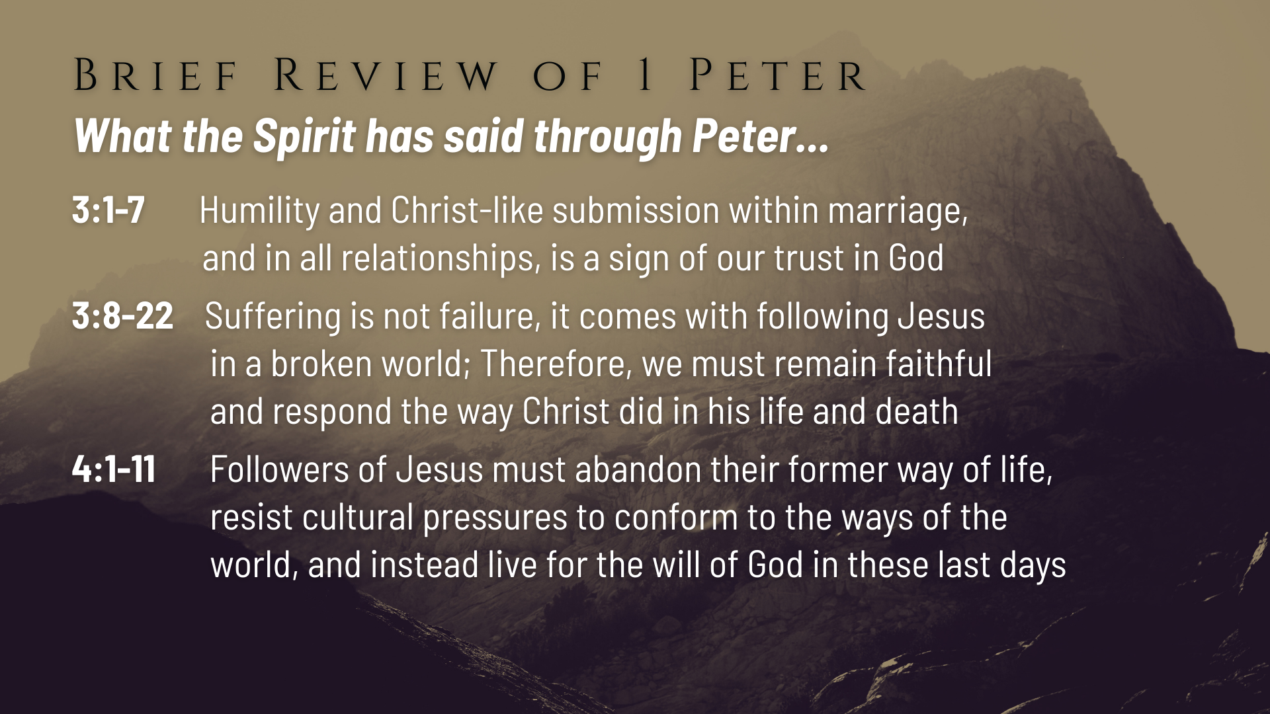
Notes:
[READ SLIDE & COMMENT]
And last week in chapter 4, verses 12-19, we heard the Spirit say… [NEXT SLIDE]

Slide 6
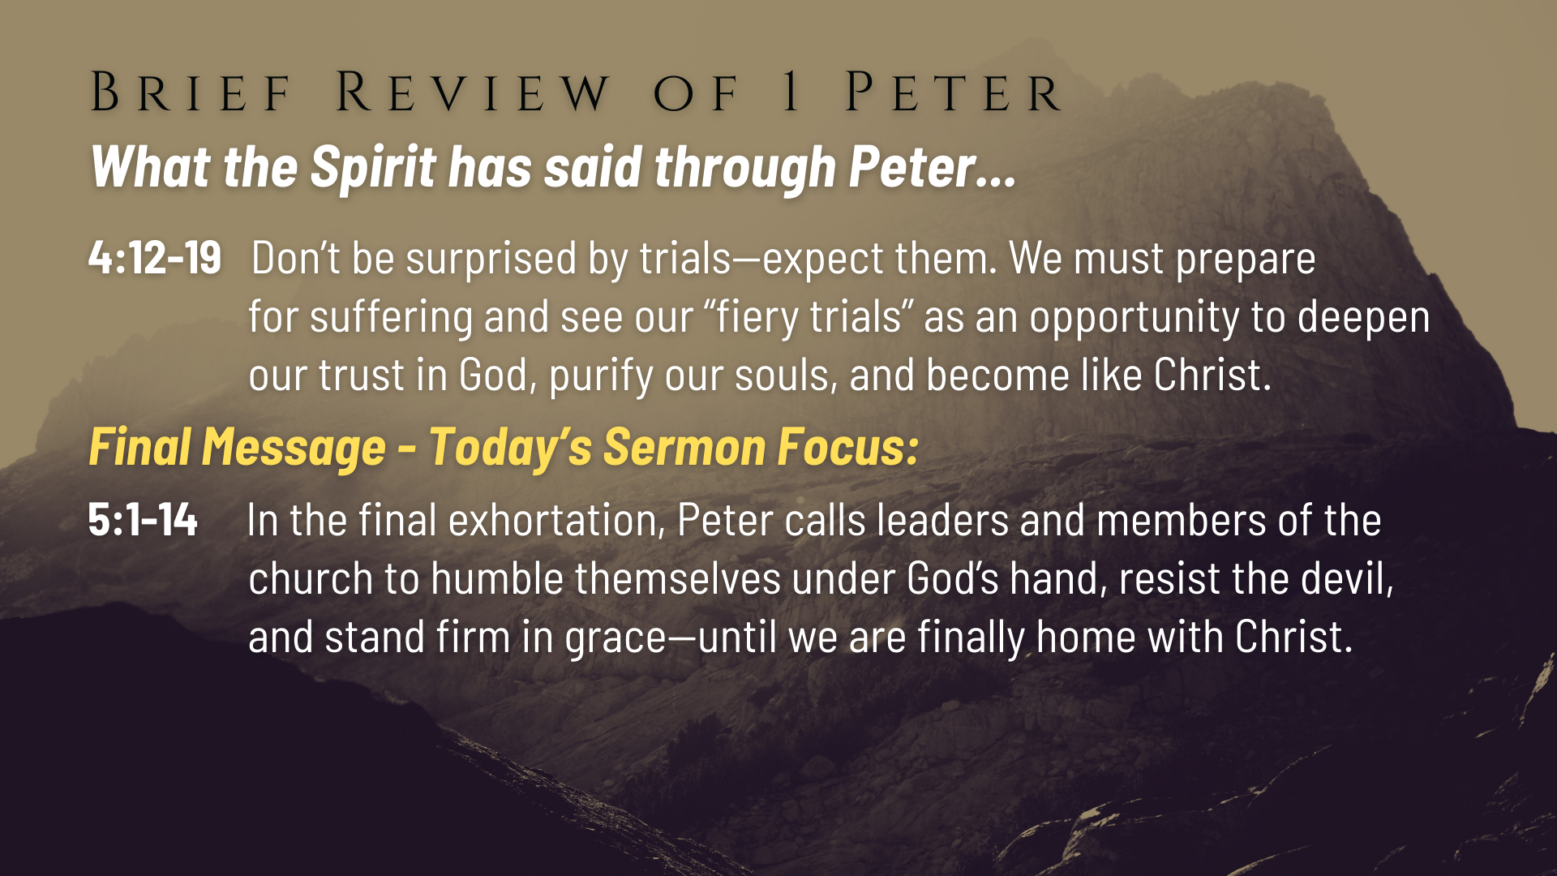
Notes:
Don’t be surprised by trials—expect them. We must prepare for suffering and see our “fiery trials” as an opportunity to deepen our trust in God, purify our souls, and become like Christ.
Which brings us to the final message in our series, which covers the last chapter in 1 Peter. It’s in the closing of his letter, we will hear Peter encourage and remind us—in a world of pressure and opposition—that God calls his people to lead humbly, live faithfully, resist the devil, and stand firm in his grace until we are finally at home with Christ.
And so, let’s open up our Bibles to 1 Peter chapter 5. And if you’re taking notes, I’ve entitled this message… [NEXT SLIDE]

Slide 7

Notes:
Shepherds, Strangers & the Grace of God.
[BRIEF PRAYER & THEN NEXT SLIDE]

Slide 8

Notes:
v. 1 – “the elders” (presbyteros) – Peter isn’t referring to the senior adults in the church, but to the spiritual leaders (often older, certainly spiritually mature and gifted to lead, teach, and care for others); “elders” is being used as a title of an office within the church. Peter is a “fellow elder” – meaning he knows and can empathize with what they must do; “witness of Christ’s sufferings” refers to his first-hand experience of Jesus’s life, death, and resurrection; and he will ”share in the glory” (the unspeakable things to come) “to be revealed” (a NT way of referring to the appearing or second coming of Jesus.
v. 2 – “shepherds of God’s flock” – a shepherd watched over, guided, and guarded the sheep, and so it is with the spiritual shepherds of the church; ”not because you must” (not out of drudgery or obligation), but because they are “willing” (joyful surrender to the task); not for “dishonest gain” (for accruing wealth) but because you want to serve.
v. 3 – “lording it over” (i.e., using your position to do what you want, get what you want, throw your weight around, etc.), but rather by being living “examples” or reflections of Jesus.
Remember what Jesus said about this to his disciples… [NEXT SLIDE]

Slide 9
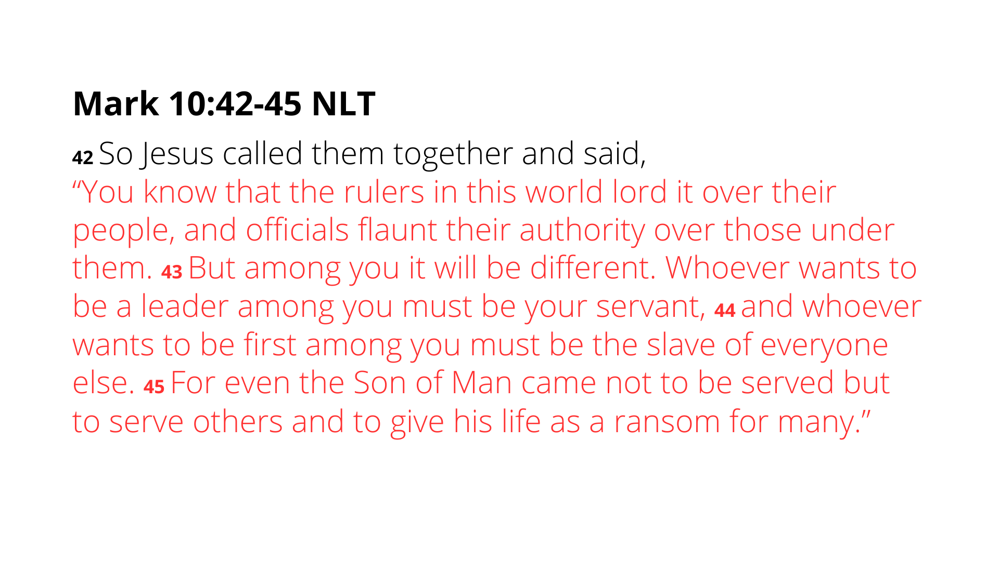
Notes:
[READ PASSAGE & COMMENT]
Back to 1 Peter 5, verse 4… [NEXT SLIDE]

Slide 10
Notes:
v. 4 – “Chief Shepherd” (Jesus) “appears” (comes again); the “crown of glory”(a grand prize given for the winner of a race, a laurel wreath: a circular crown of interwoven bay laurel leaves worn on the head, primarily as a symbol of victory, triumph, honor, and distinction; Peter says Jesus will give the faithful elders/leaders one that will never wither.
v. 5 – “submit” (i.e., recognize their calling, yield to them out of respect and the position God has given them; don’t make their job more difficult, remember, they are there to serve you); “clothe” yourself with “humility” – see how Jesus is described in Philippians 2:5-8.
[READ & COMMENT ON VERSES 6-9]
And being an avid viewer of movies, these words of Peter remind me of a late 90’s film that I really like called… [NEXT SLIDE]

Slide 11

Notes:
[THE GHOST IN THE DARKNESS - DESCRIBE MOVIE]
Starring Michael Douglas and Val Kilmer
Set in the late 1800s; a bridge builder (John Patterson) is hired by the British empire to build a bridge in Tsavo, located in East Africa (Kenya); during construction (in the day and at night) workers are being killed by two lions, and so Patterson, with the help of a hunter, Douglas’ character, set out to hunt down and kill the lions
The movie is inspired by the true story; over 100 people are said to have died; and it’s a bizarre story because of the odd (dare I say “evil”) behavior of the lions; male lions don’t normally hunt in pairs, and it seems they were killing for sport
In the film, a lead worker who was protesting the continuation of the build because of the killings, says, “the devil has come to Tsavo”
The two male lions (seen on the screen) are housed in the Field Museum in Chicago
And these last few verses of Peter (which presents an image of the devil as a crazy lion) are very similar to James 4:6-8: “And [God] gives grace generously. As the Scriptures say, “God opposes the proud but gives grace to the humble.” So, humble yourselves before God. Resist the devil, and he will flee from you. Come close to God, and God will come close to you.” Notice, for both Peter and James, “humility” (i.e., a lack of pride, the sin which led to the devil’s downfall), is, along with the armor of God in Eph 6, how we resist the evil one.
Back to our remaining verses in 1 Peter 5, verse 10… [NEXT SLIDE]

Slide 12
Notes:
[READ & COMMENT ON VERSES 10-11]
And finally… Peter’s farewell greeting and encouragement to these sojourners…
[READ VERSES 12-14]
Silas – a co-worker with Peter, which we read about in Acts, brings them his letter
“true grace of God” – the way it really is; reflective of God’s will and desire for us; it’s his grace that allows us to receive this word and walk in its truth as sojourners
“Babylon” is code for Rome, and also reminds them they are exiles living in an empire
“my son Mark” – Mark was a spiritual son, learner, and companion of Peter
Before we close with some reflection questions, let’s sum up what we’ve covered today and think about how it might apply to us… [NEXT SLIDE]

Slide 13
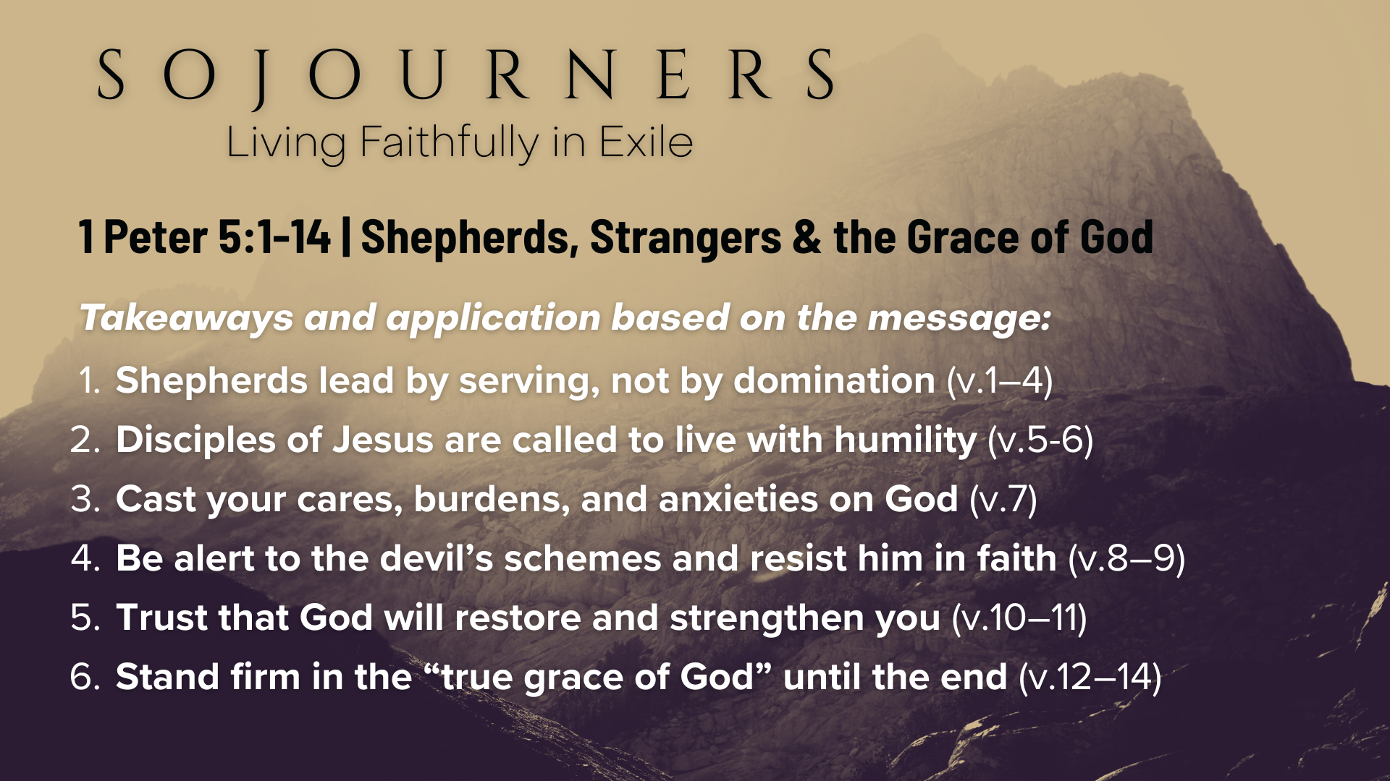
Notes:
Shepherds lead by serving, not by domination (v.1–4)
Disciples of Jesus are called to live with humility (v.5-6)
Cast your cares, burdens, and anxieties on God (v.7)
Be alert to the devil’s schemes and resist him in faith (v.8–9)
Trust that God will restore and strengthen you (v.10–11)
Stand firm in the “true grace of God” until the end (v.12–14)
Finally, here are some questions to help us reflect and respond to what the Spirit is saying to us through the message… [NEXT SLIDE]

Slide 14
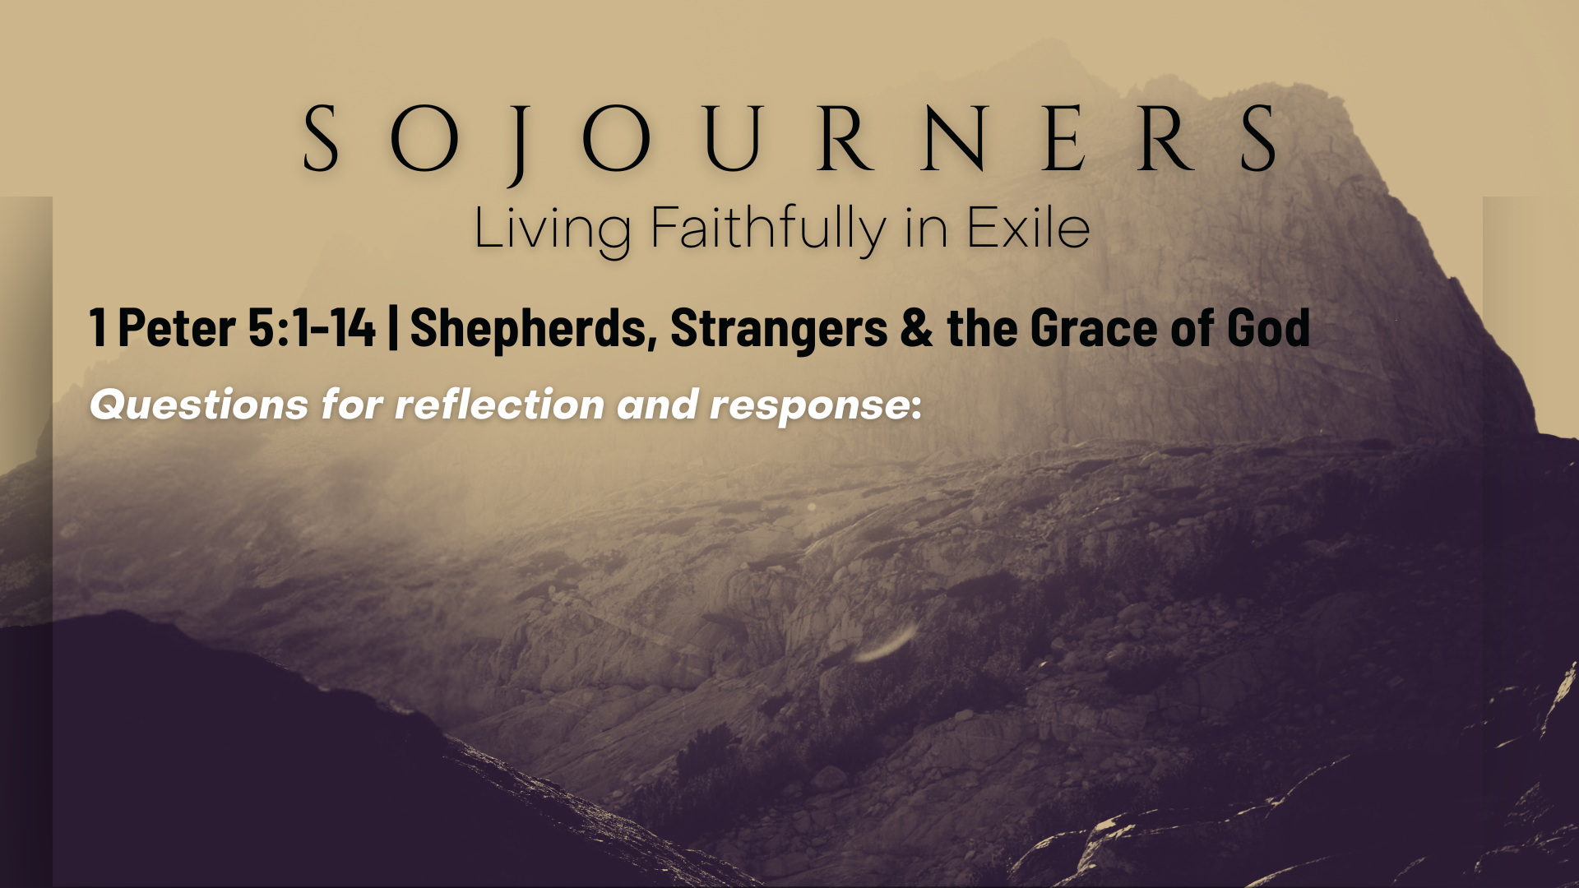

Slide 15
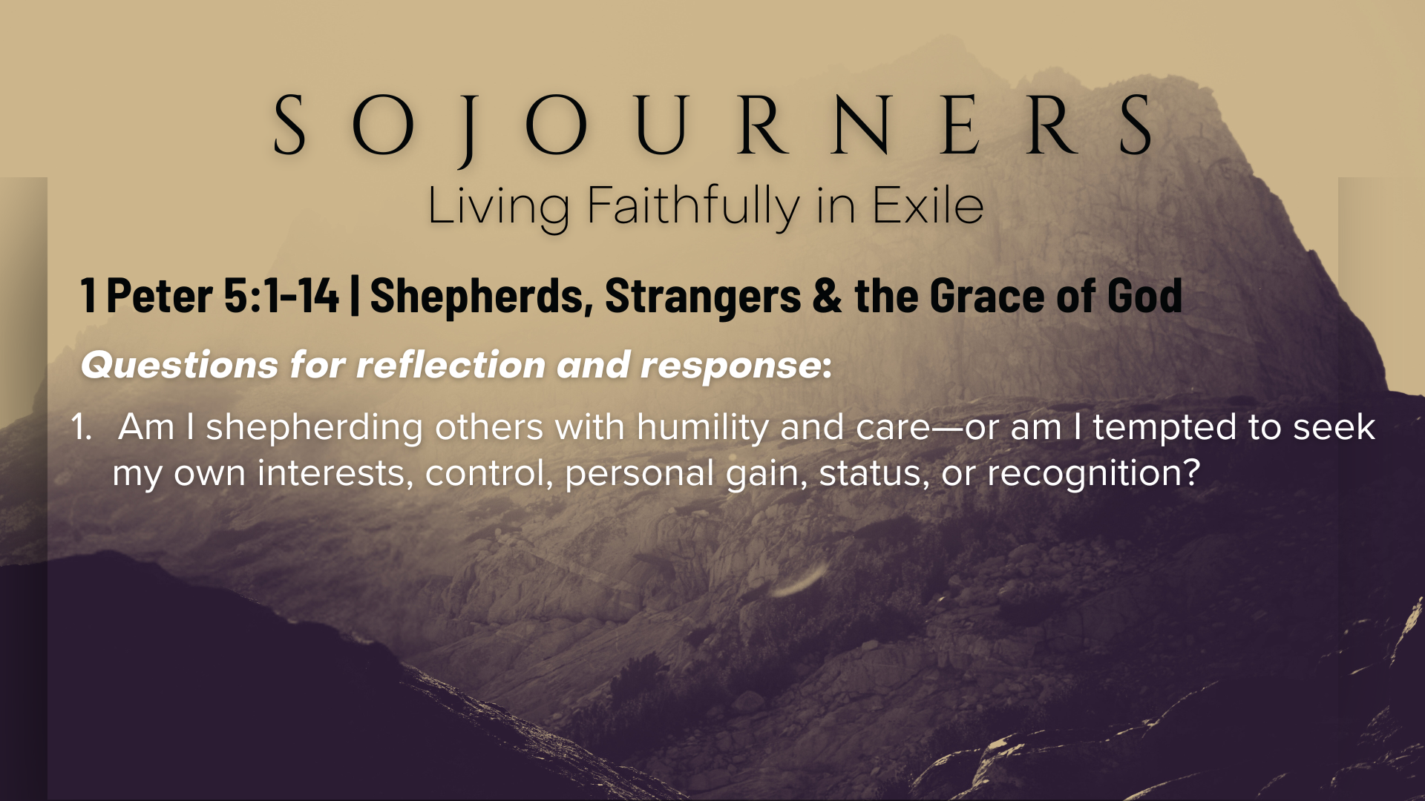

Slide 16
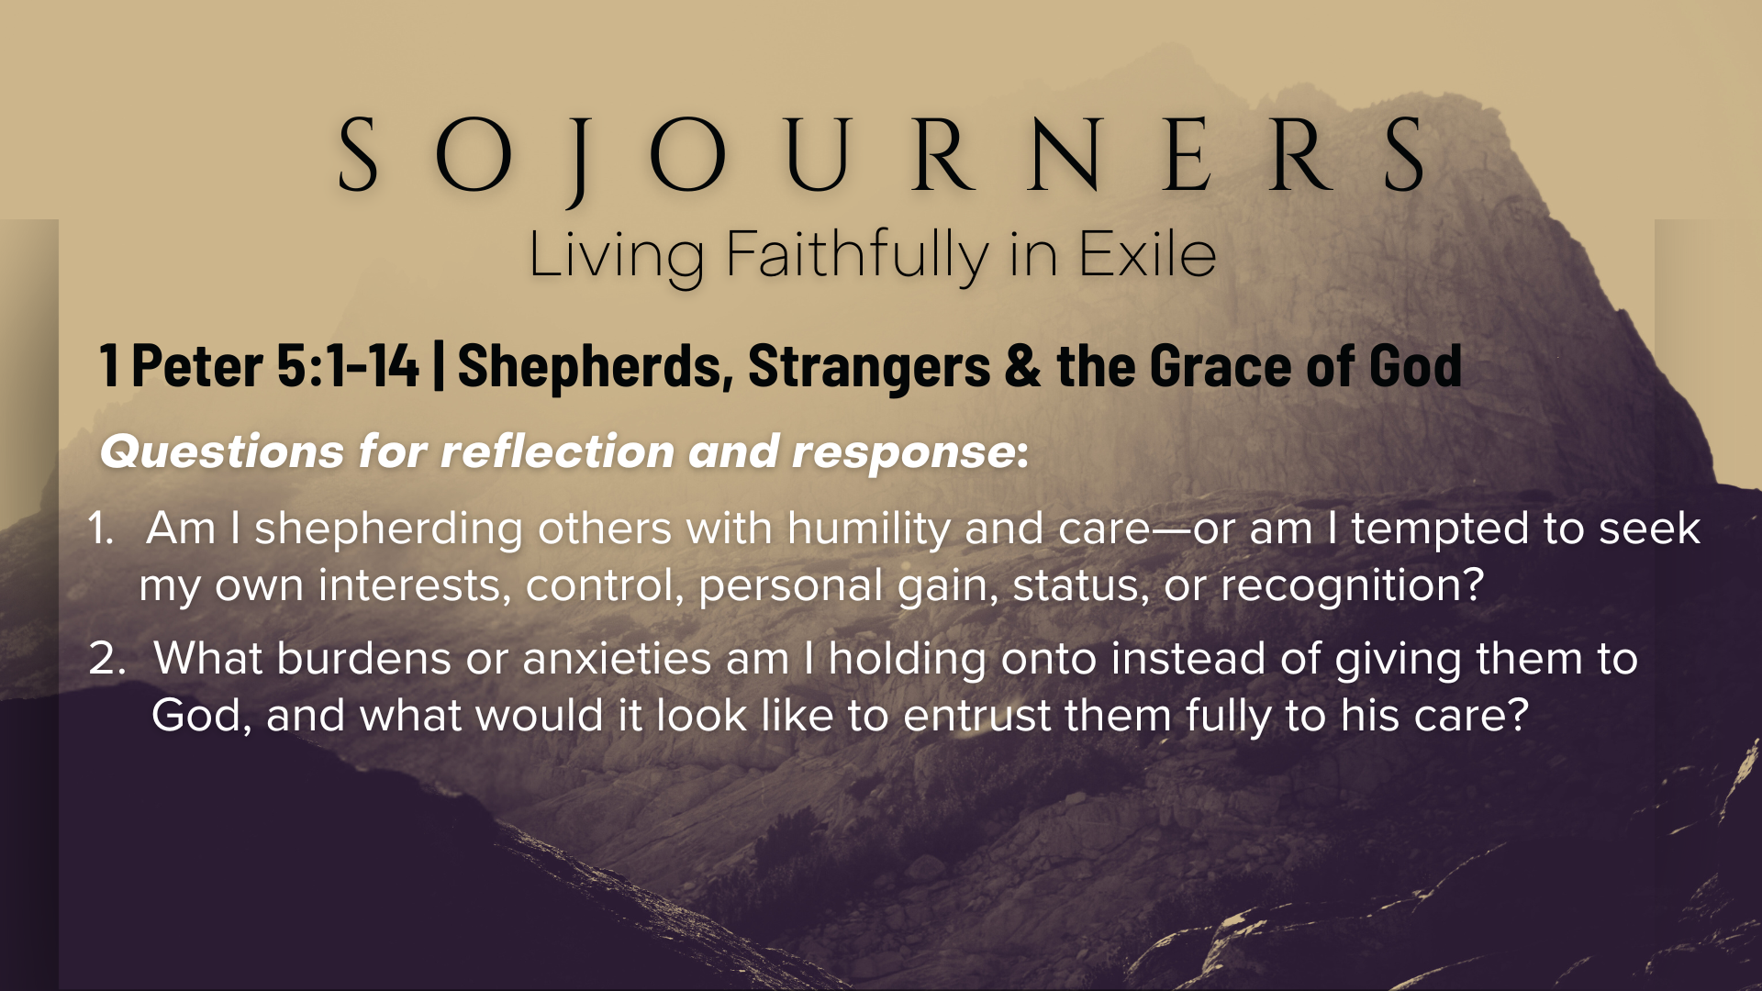

Slide 17
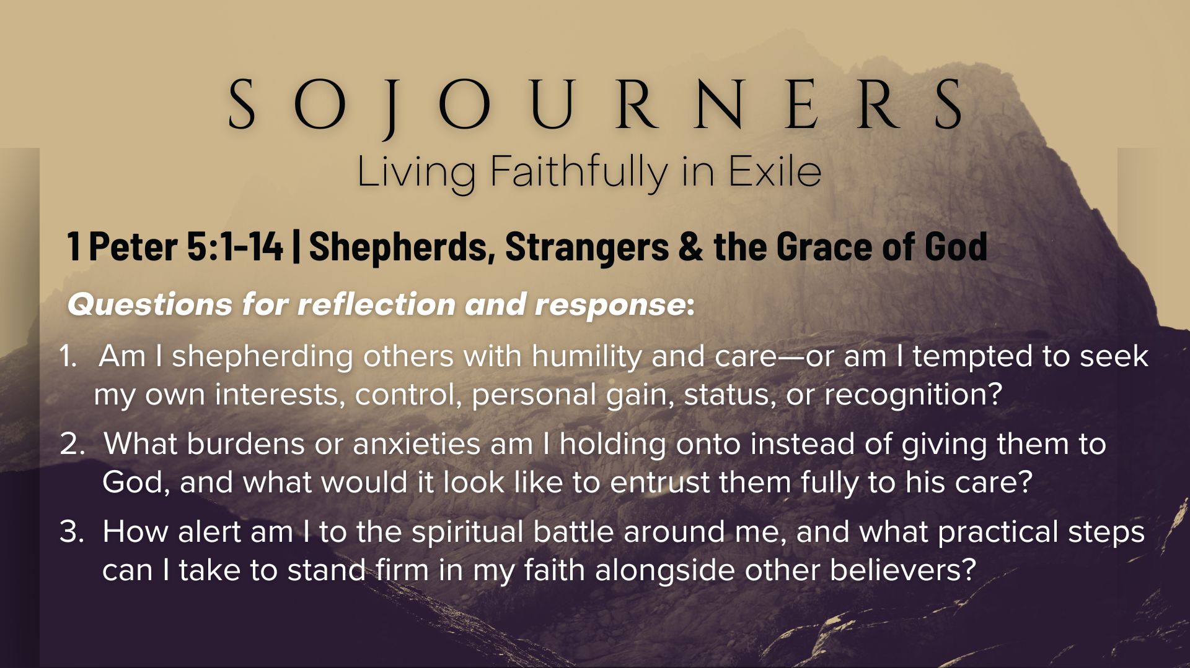
Notes:
[READ & BRIEF COMMENT ON EACH QUESTION]
Am I shepherding others with humility and care—or am I tempted to seek my own interests, control, personal gain, status, or recognition?
What burdens or anxieties am I holding onto instead of giving them to God, and what would it look like to entrust them fully to his care?
How alert am I to the spiritual battle around me, and what practical steps can I take to stand firm in my faith alongside other believers?
[CLOSING WORDS]
Let’s pray… [NEXT SLIDE FOR CLOSING PRAYER]

Slide 18

Notes:
[CLOSING PRAYER]
Announcements: (1) Fall Kickoff & New Sermon Series; (2) College Lunch
Benediction
Chosen people of God, as sojourners and exiles in this world,
set your hearts on the Living Hope – Christ risen and reigning.
As you go into the world,
may you walk in hope,
stand firm in God’s grace,
shine with the love of Jesus,
and allow the Spirit to sustain you in all things,
until the day your sojourning gives way to glory.
Go in peace, church,
and live faithfully in exile.
Amen.

